Slide 1

Vietnamese Social Media Emotion Corpus

Slide 2

Group Member
Nguyễn Thành Khang

Slide 3

Collecting data
1. Choosing three Vietnamese videos on YouTube with at least 100 comments. Crawling the first 100 comments of each videos.
Please find the Crawl Data Example.ipynb for an example of crawling.
2. Label these comments by yourself in seven classes: Disgust (chán ghét), Enjoyment(thích thú), Anger (giận dữ), Surprise (ngạc nhiên), Sadness (buồn bã), Fear (sợ hãi),Other (khác).

Slide 4
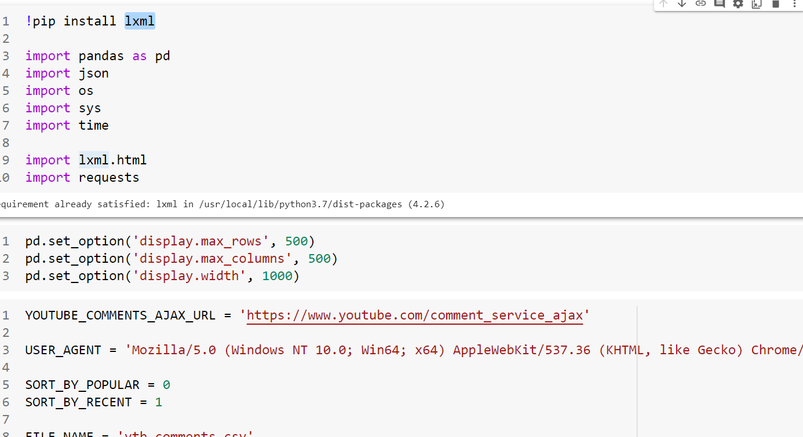
Get a random Youtube comment from a video without using the Youtube API

Slide 5
Use lxml
lxml is a Pythonic, mature binding for the libxml2 and libxslt libraries. It provides safe and convenient access to these libraries using the ElementTree API.
It extends the Element Tree API significantly to offer support for XPath, RelaxNG, XML Schema, XSLT, C14N and much more.

Slide 6
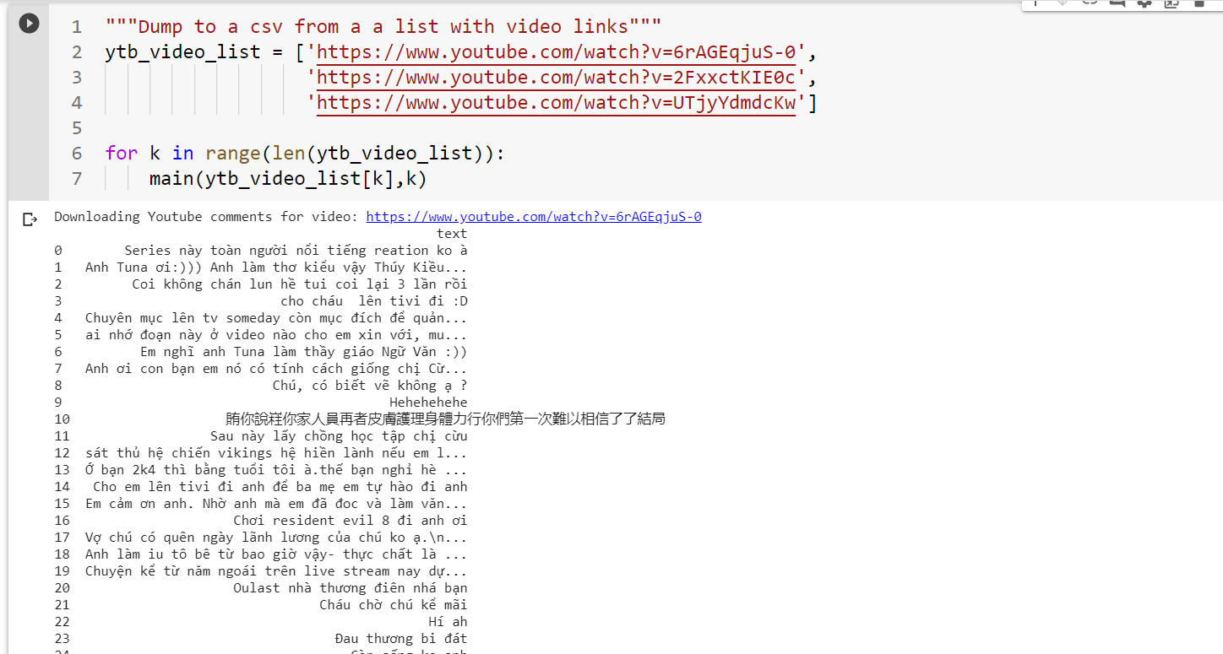

Slide 7
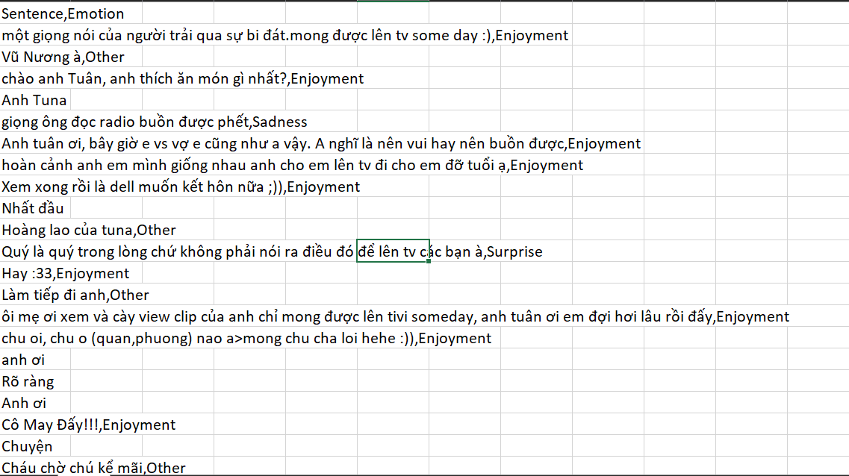

Slide 8

Task 2. (30%) Emotion Recognition for Vietnamese Social Media Text
1. Using training and validation sets of UIT-VSMEC (UIT-VSMEC.zip) for training your Emotion Recognition model (classification model).
Note: you can choose any technique in preprocessing, any classifier that you want.
2. Report the performance metrics (Accuracy, F1-score...) for the test set in UIT-VSMEC dataset.

Slide 9

Sentiment Analysis:
The process of computationally identifying and categorizing opinions expressed in a piece of text, especially in order to determine whether the writer's attitude towards a particular topic, product, etc. is Disgust (chán ghét), Enjoyment(thích thú), Anger (giận dữ), Surprise (ngạc nhiên), Sadness (buồn bã), Fear (sợ hãi),Other (khác).

Slide 10

Data collection and analysis

Slide 11
Table 1: Examples of emotion-labeled sentences.
No. | Vietnamese sentences | English translation | Emotion
1 | Ảnh đẹp quá! | The picture is so beautiful! | Enjoyment
2 | Tao khóc..huhu.. Tao rớt rồi | I’m crying..huhu.. I failed the exam. | Sadness
3 | Khuôn mặt của tên đó vẫn còn ám ảnh tao. | The face of that man still haunts me. | Fear
4 | Cái gì cơ? Bắt bỏ tù lũ khốn đó hết! | What the fuck? Arrest all those goddamn bastards! | Anger
5 | Thật không thể tin nổi, tại sao lại nhanh đến thế?? | It’s unbelievable, why can be that fast?? | Surprise
6 | Những điều nó nói làm tao buồn nôn. | What he said makes me puke. | Disgust

Slide 12

Table 2: Annotation agreement of the UIT-VSMEC corpus (%
Stage | Annotators | P0 | Pe | Am
1 | X1-X2-X3-Y (806 sentences) | 92.66 | 56.98 | 82.94
2 | X1-Y (2,032 sentences) | 88.00 | 18.61 | 85.25
 | X2-Y (2,112 sentences) | 86.27 | 31.23 | 80.03
 | X3-Y (1,977 sentences) | 92.81 | 33.95 | 89.12

Slide 13
Table 3: Statistics of emotion labels of the UIT-VSMEC corpus
Emotion | Sentences | Percentage (%)
Enjoyment | 1,965 | 28.36
Disgust | 1,338 | 19.31
Sadness | 1,149 | 16.59
Anger | 480 | 6.92
Fear | 395 | 5.70
Surprise | 309 | 4.46
Other | 1,291 | 18.66
Total | 6,927 | 100

Slide 14
Table 4: Distribution of emotion-annotated sentences according to the length of the sentence (%)
ength | Enjoyment | Disgust | Sadness | Anger | Fear | Surprise | Other | Overall
1-5 | 5.16 | 2.84 | 1.70 | 0.69 | 0.94 | 0.85 | 1.87 | 14.05
6-10 | 8.98 | 4.22 | 4.98 | 1.41 | 1.42 | 2.25 | 7.20 | 30.38
10-15 | 5.87 | 3.99 | 4.11 | 1.40 | 1.27 | 0.94 | 5.00 | 22.58
16-20 | 4.17 | 3.05 | 2.51 | 1.14 | 0.85 | 0.24 | 2.79 | 14.75
21-25 | 1.96 | 1.93 | 1.50 | 0.66 | 0.40 | 0.15 | 1.11 | 7.71
26-30 | 1.08 | 1.31 | 0.95 | 0.45 | 0.27 | 0.01 | 0.53 | 4.6
>30 | 1.23 | 1.97 | 0.84 | 1.17 | 0.55 | 0.02 | 0.15 | 5.93
Total | 28.36 | 19.31 | 16.59 | 6.92 | 5.70 | 4.46 | 18.66 | 100

Slide 15
Table 5: Experimental results by Orange3 of machine learning models on 1,000 emotion-annotated sentences from the UIT-VSMEC corpus (%)
Method | Accuracy | Weighted F1
Random Forest | 35.8 | 32.8
SVM | 37.6 | 37.0
Decision Tree | 30.5 | 29.6
kNN | 28.9 | 27.1
Naĩve Bayes | 20.8 | 19.2

Slide 16
Table 6: Vietnamese abbreviations in the dataset.
No. | Abbreviation | Vietnamese meaning | English meaning
1 | “dc” or “dk” or “duoc” | ”được” | ”ok”
2 | “ng” or “ngừi” | ”người” | ”people”
3 | ”trc” or ”trk” | ”trước” | ”before”
4 | ”cg” or ”cug” or ”cũg” | ”cũng” | ”also”
5 | ”mk” or ”mik” or ”mh” | ”mình” | ”I”

Slide 17
Table 7: Statistics of emotion-labeled sentences in training, validation and test sets.
Emotion | Train | Dev | Test | Total
Enjoyment | 1,573 | 205 | 187 | 1,965
Disgust | 1,064 | 141 | 133 | 1,338
Sadness | 938 | 92 | 119 | 1,149
Anger | 395 | 38 | 47 | 480
Fear | 317 | 38 | 47 | 395
Surprise | 242 | 36 | 31 | 309
Other | 1,019 | 132 | 140 | 1,291
All | 5,548 | 686 | 693 | 6,927

Slide 18
Table 8: Experimental results of the UIT-VSMEC corpus.
Corpus | Algorithm | Accuracy(%) | Weighted F1-Score(%)
Original | RandomForest+BoW | 50.64 | 40.11
 | SVM+BoW | 58.00 | 56.87
 | LSTM+word2Vec | 53.39 | 53.30
 | LSTM+fastText | 54.25 | 53.77
 | CNN+word2Vec | 59.74 | 59.74
 | CNN+fastText | 56.85 | 56.79
Without Other | RandomForest+BoW | 50.64 | 49.14
label | SVM+BoW | 63.12 | 62.45
 | LSTM+word2Vec | 61.70 | 61.09
 | LSTM+fastText | 62.06 | 61.83
 | CNN+word2Vec | 66.48 | 66.34
 | CNN+fastText | 63.47 | 62.68

Slide 19


Attention-based LSTM sentiment classifier.

Slide 20
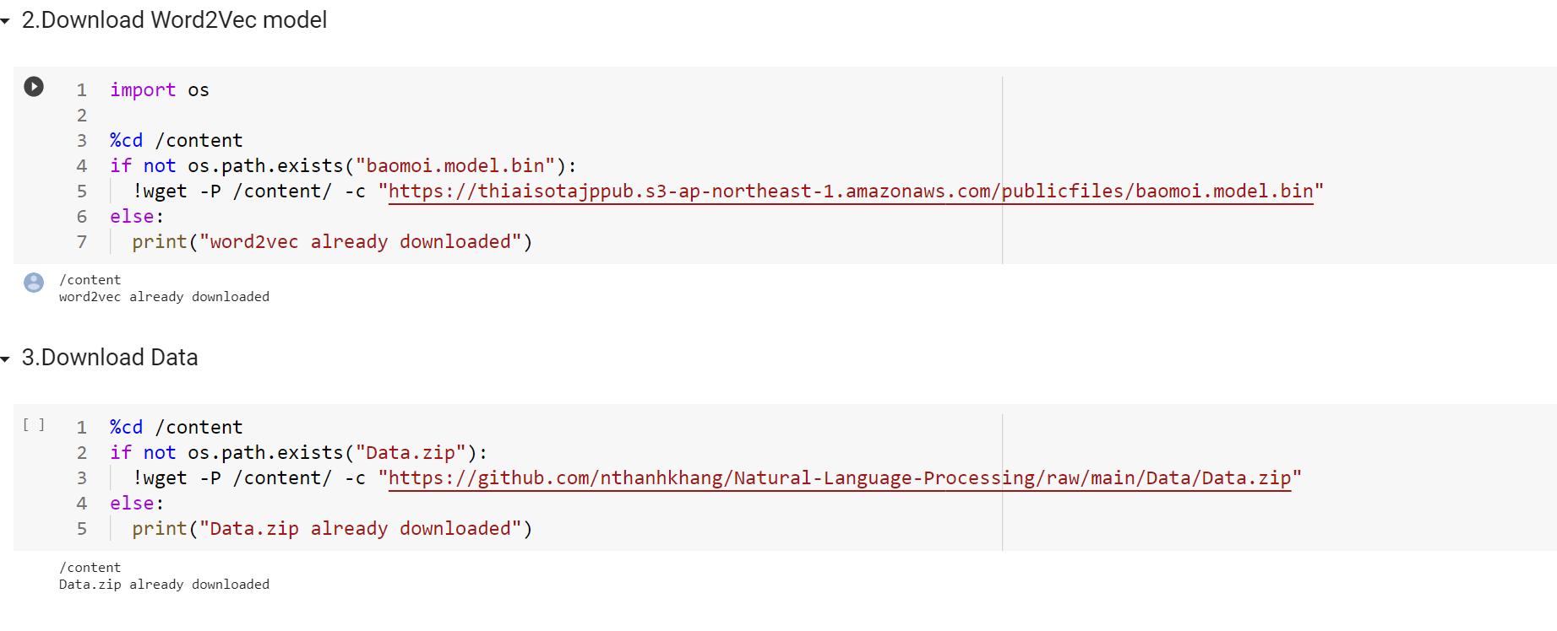
First, we import data,model Word2Vec from GitHub

Slide 21
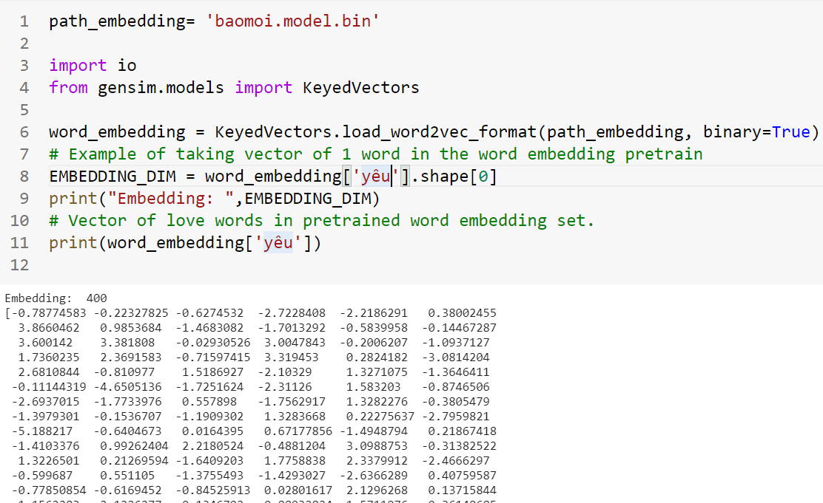
Function reading pretrain word embedding library. The word embedding pretrain has been trained in new news, 300-way news

Slide 22
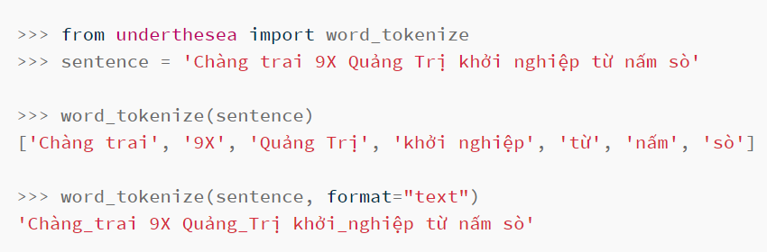
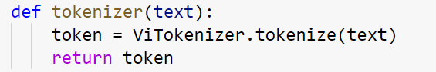
Word Segmentation
!pip install underthesea ✨🍰✨

Slide 23
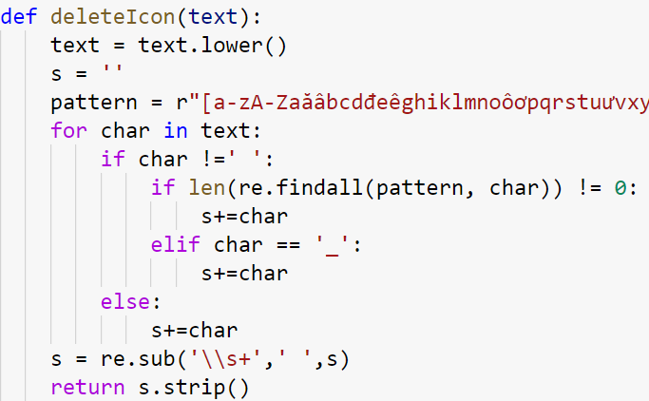

Delete Icon in data

Slide 24
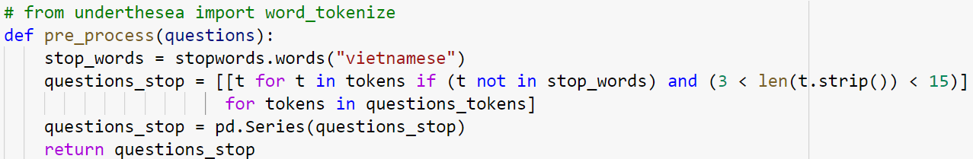
StopWord Vietnamese by undersea open source

Slide 25
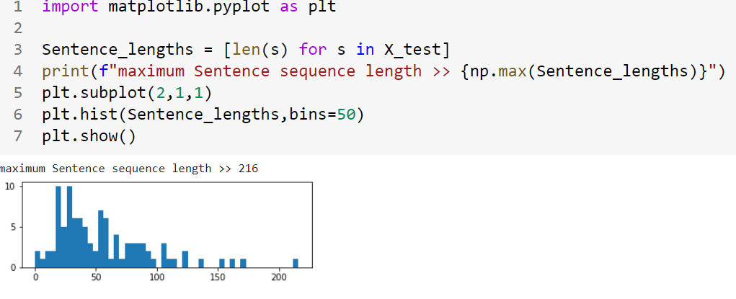
find maximum Sentence sequence length

Slide 26
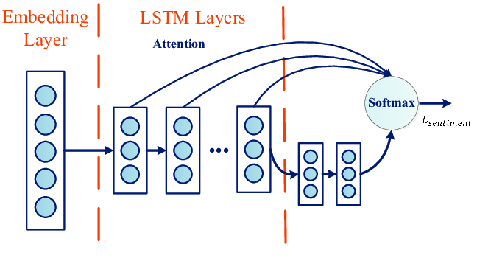
LSTM

Slide 27
LSTM
All the words in the X_train set will form a dictionary
Each vector of the input word, it will turn into a vector with a fixed number of dimensions and each vocabulary will be replaced by its index in the dictionary
Number of vector dimensions per input we will take the longest sentence which is the direction of the vector and the shorter arcs will automatically add the value 0 after

Slide 28
Build Mode
Next, I compose the LSTM Network. Note that embed_dim, lstm_out, batch_size, droupout_x variables are hyperparameters, their values are somehow intuitive, can be and must be played with in order to achieve good results. Please also note that I am using softmax as activation function. The reason is that our Network is using categorical crossentropy, and softmax is just the right activation method for that.

Slide 29
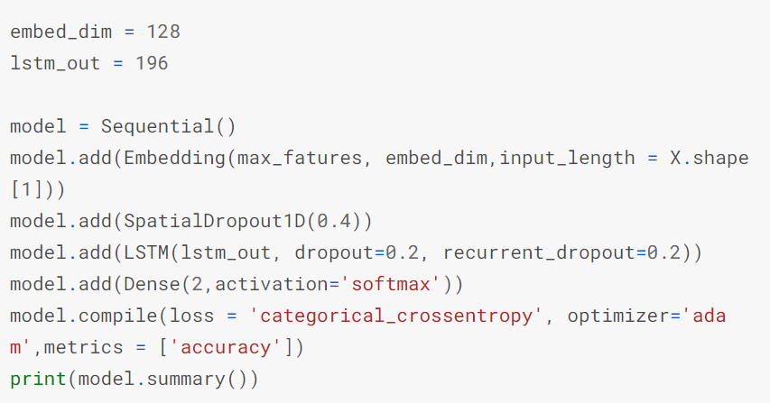

Slide 30
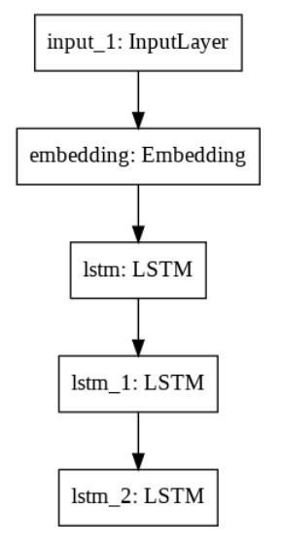
encoder

Slide 31
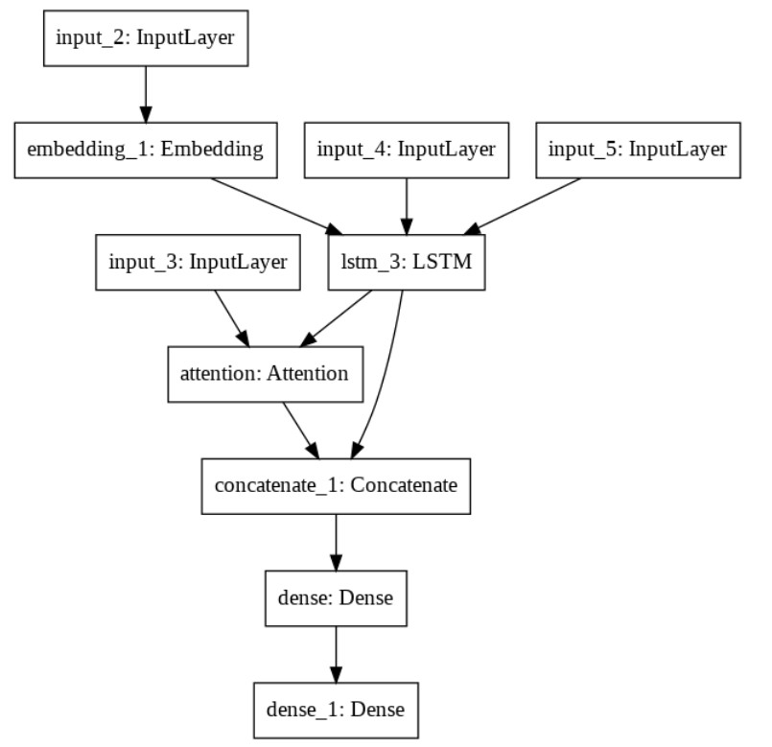
decoder

Slide 32
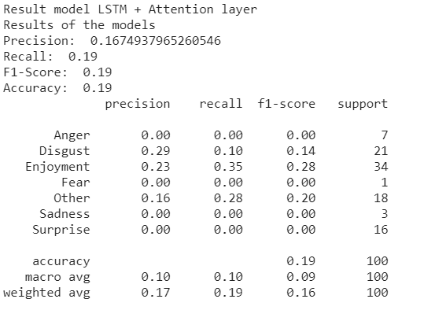
Report the performance metrics (Accuracy, F1-score...)

Slide 33
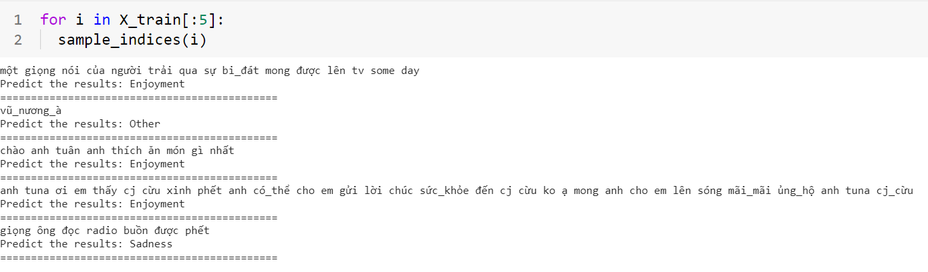
Results on train dataset

Slide 34

Results on sentence

Slide 35

Task 3. (30%) Applying the trained model in Task 2 to three datasets in Task 1. Then, report the performance metrics (Accuracy, F1-score...) for these datasets.

Slide 36
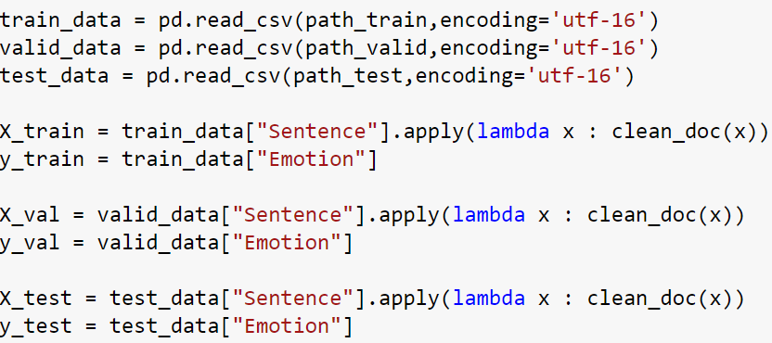
Part 3 does the same step as option part 2 must endcoding = 'utf-16'

Slide 37

thank for listening

Slide 38

Reference
LSTM Sentiment Analysis | Keras | Kaggle
0dust/Sentiment-Analysis-with-Attention: Sentiment analysis using LSTM with attention mechanism in keras. (github.com)
pytorch-sentiment-analysis/6 - Transformers for Sentiment Analysis.ipynb at master · bentrevett/pytorch-sentiment-analysis (github.com)

